Slide 1



Website development to help NGO spread it’s awareness
By TEAM One_piece

Slide 2


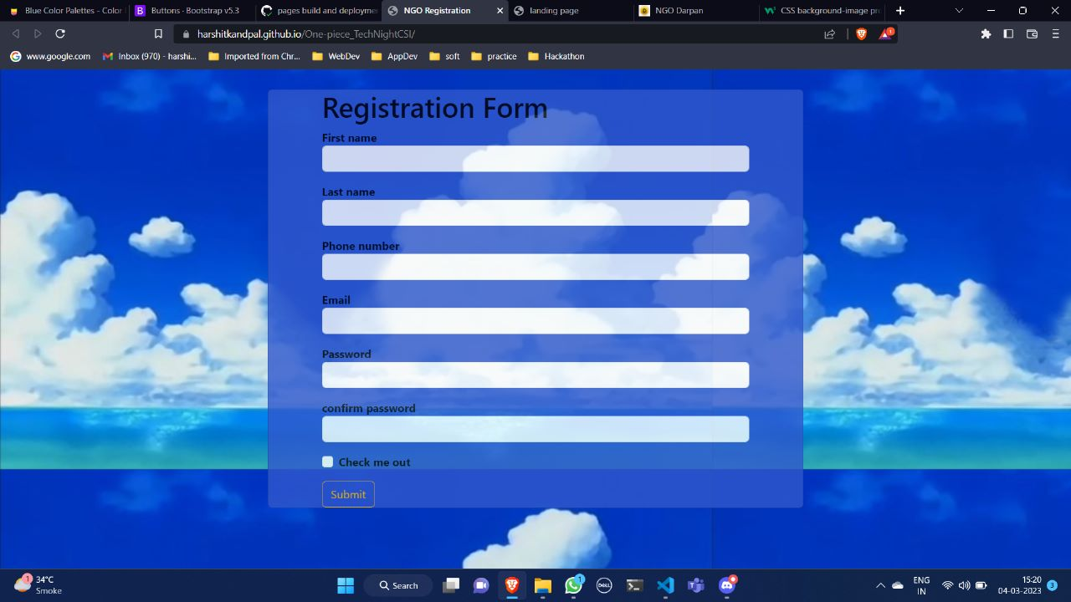
REGISTERATION PAGE
This site is a standard registration site for donation page

Slide 3
Following files are use in making this site
Html file :index.html
Javascript File :index.js
CSS File:styles.css

Slide 4
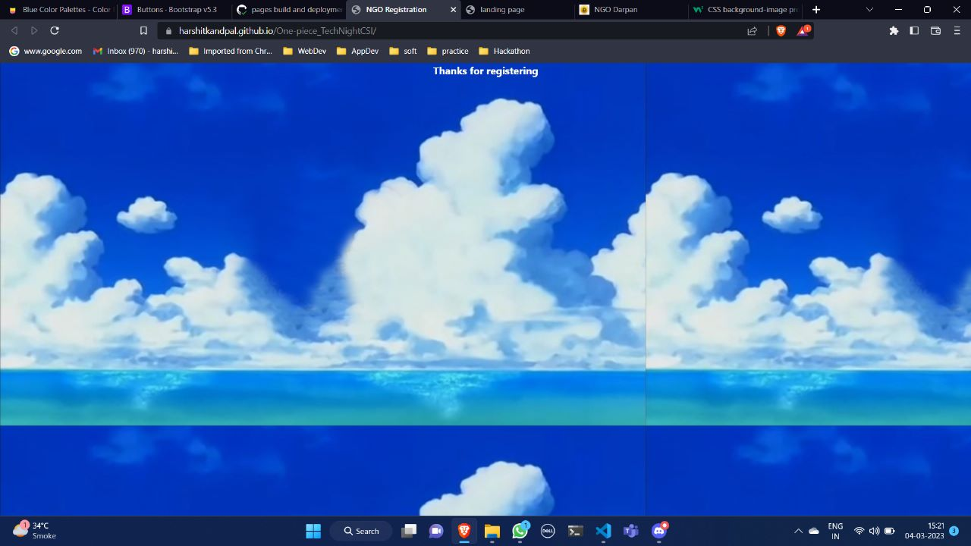
Landing PAGE
This site is a standard landing site for donation page

